Slide 1
SSW-810: Software Engineering Tools and Techniques
Strings, Slices, Files, and
Coding Style Guidelines
Prof. Jim Rowland
Software Engineering
School of Systems and Enterprises

Slide 2
Acknowledgements
This lecture includes material from:
“How to Think Like a Computer Scientist: Learning with Python 3 (RLE)”, Peter Wentworth, Jeffrey Elkner, Allen B. Downey, and Chris Meyers,
http://openbookproject.net/thinkcs/python/english3e/
“Introducing Python”, Bill Lubanovic, ISBN-13: 978-1449359362
http://proquest.safaribooksonline.com/book/programming/python/9781449361167
https://docs.python.org/3/library/stdtypes.html
https://mkaz.tech/python-string-format.html

Slide 3

Today’s topics
Strings
Slices
Working with files
Working with JSON
Reading from the Web
Coding style guidelines

Slide 4
Text processing with Python
Python is exceptionally good at data processing
Applications include:
Data Science/Big Data
Data Engineering
Natural Language Processing
Machine Learning
Very powerful string manipulation features

Slide 5
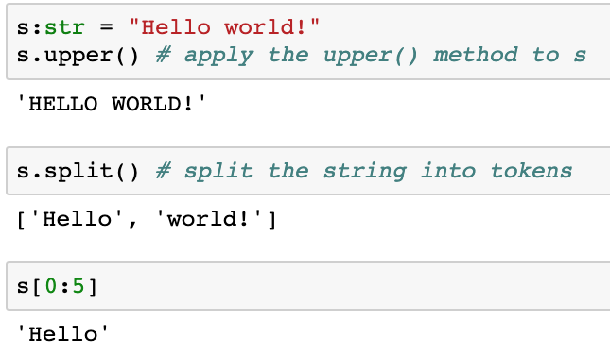
Strings
Strings are compound data types
A string data type is made up of character data types
Use the string as an object or use its parts (the characters)
Strings have many useful operations

Slide 6
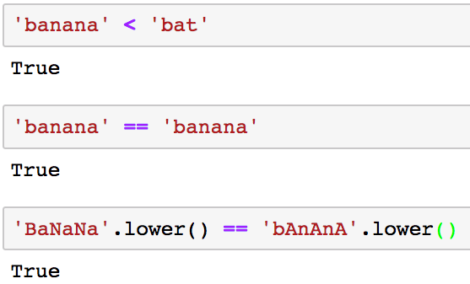
Comparing strings
Comparison operators work as expected
You may want to convert strings to lower case when comparing
and/or counting word occurrences so ‘YES’, ‘Yes’, and ‘yes’ are the same word
The string is not changed: lower()returns a new string

Slide 7
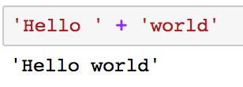
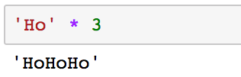
Python string manipulation
Concatenation
Replication

Slide 8
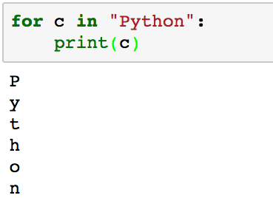
Strings and iterators
Recall you can use strings as sequences that can be used with iterators

Slide 9
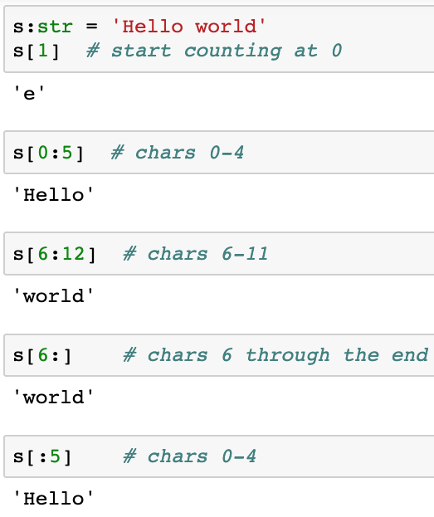
Subsets of strings with slices
Choose a subset of a string with slices
Slices work the same way with other sequences, e.g. lists, tuples

Slide 10
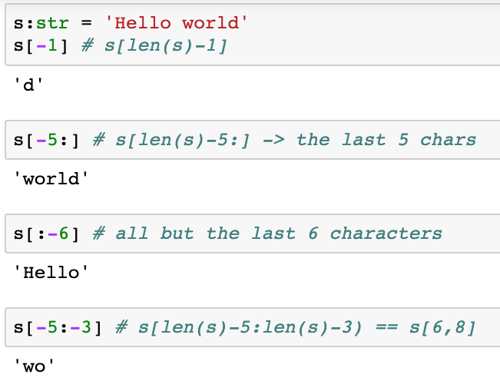
Subsets of strings with slices
The slice index may also be negative (from the end)
Think of a negative index i as len(s) - i

Slide 11
Slices of sequences
[ start : end : step ]
start - the offset from the beginning (offset from 0)
end – up to, but not including end, i.e. end – 1
step – skip every step items
start, end, and step arguments are optional

Slide 12
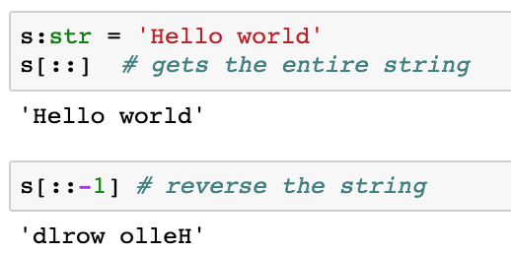
Reverse a string with slices
Problem: How to reverse a string using only slices
Recall slice[start : end : step]
We want the entire string, but we want to step from the end back to the beginning
Be careful about trading cleverness for readability!

Slide 13
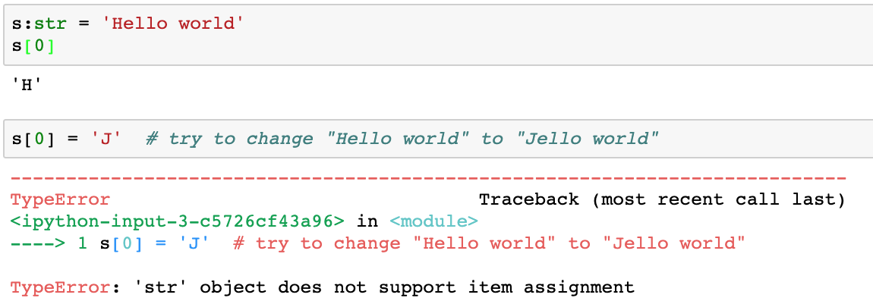
Strings are immutable

Slide 14
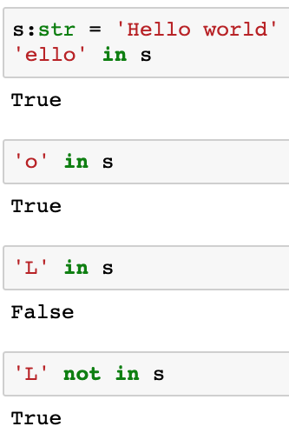
Are you in there?
Check for substrings with in and not in

Slide 15
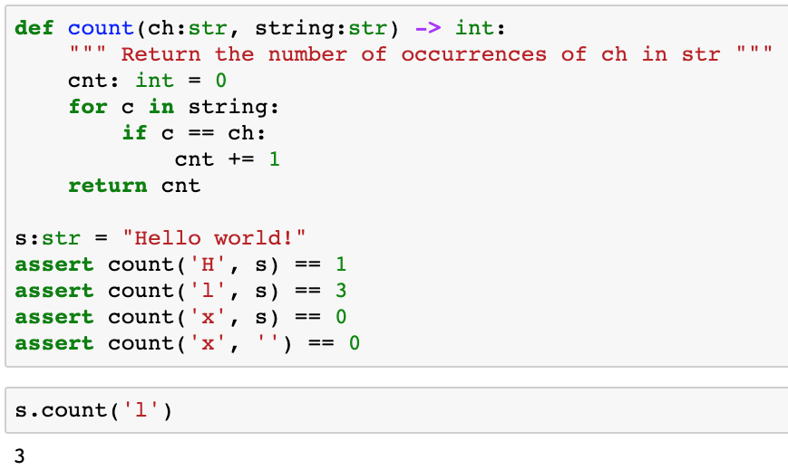
Count characters in a string
We can also use Python’s string method
s.count(‘H’)

Slide 16
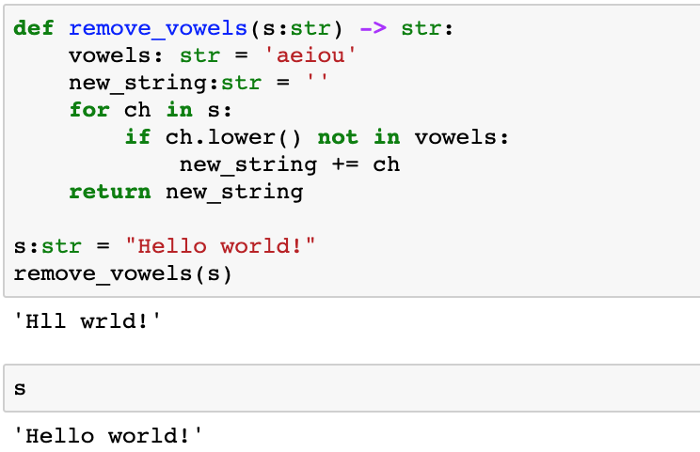
No more vowels
Use ch.lower(), not s.lower(), so the returned string matches the upper/lower case characters in s
Can use same approach to remove punctuation!
string.punctuation is string with all punctuation
Returned a copy of the string – didn’t change the string s

Slide 17
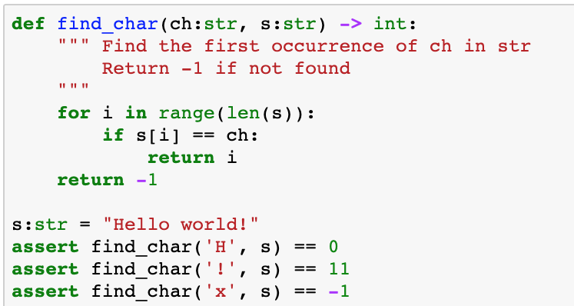
Find a character in a string: slices

Slide 18
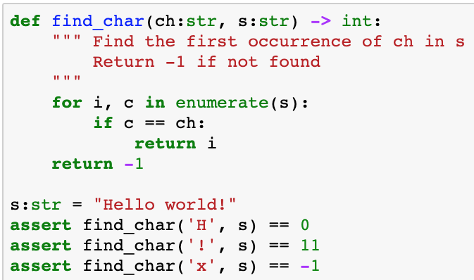
Find a character in a string: enumerate
Consider both slices and enumerate() alternatives

Slide 19
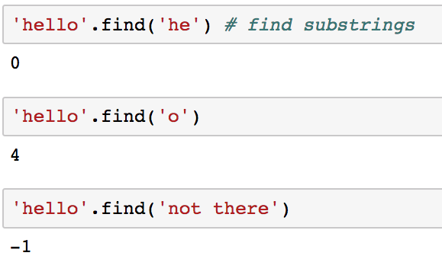
String.find(target)
Search for a target string within a string
Return the offset where the target string starts or -1
Recall that we’re calling the ‘find’ method on string ‘hello’ with the argument(‘he’)

Slide 20
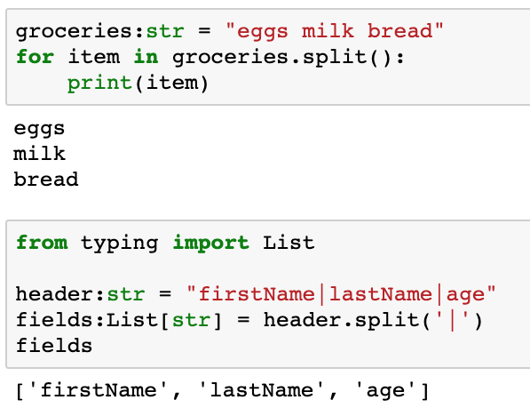
Splitting strings into tokens
Read a line and process each token in the line
string.split() with no argument defaults the separator to whitespace
string.split(arg) splits on the specified argument

Slide 21
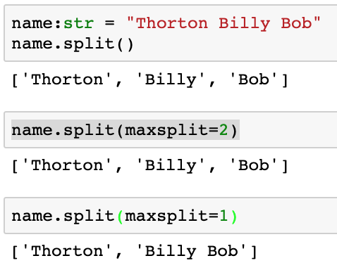

Splitting strings into tokens: maxsplit
Split a string into n components

Slide 22
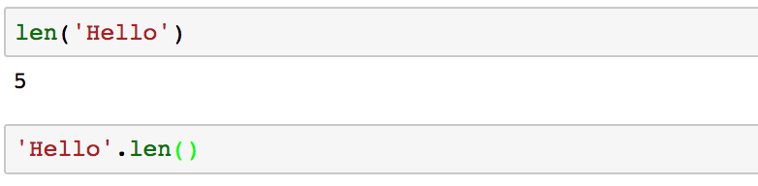
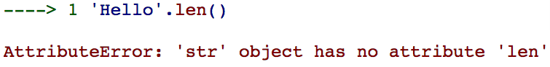
String length
Python provides built in len() function for many types which is more efficient in time and space
(But it’s an exception that you must remember)

Slide 23
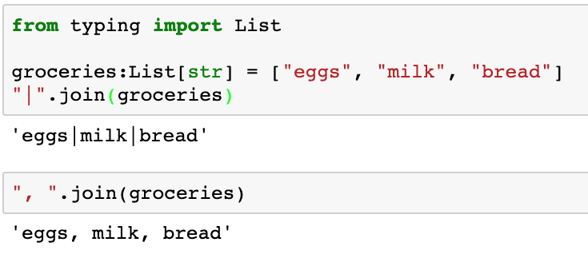
string.join(seq)
string.split(delim) splits a string into a list of tokens
string.join(seq) creates a string from a list of tokens separated by string
These string methods are used frequently!

Slide 24
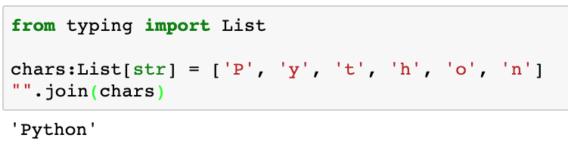
string.join(seq)
Given a list of characters, how can we create a string?
Note: seq must be a sequence of str

Slide 25
String Methods
String class supports a number of useful methods
String Method | Semantics
string.startswith(s) | returns True if string begins with s
string.endswith(s) | returns True if string ends with s
string.split([sep=whitespace],[maxsplit=-1]) | Split a string into tokens
string.strip() | strips leading and trailing whitespace
string.lstrip() | strips leading whitespace
string.rstrip() | strips trailing whitespace
See https://docs.python.org/3/library/stdtypes.html

Slide 26
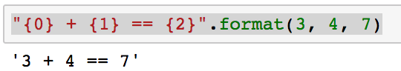
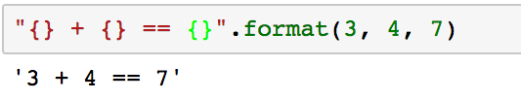
string.format()
string.format() provides a very powerful tool to create and format strings
Frequently used in print() statements, but many uses
Placeholders insert values into the string
If you don’t specify an argument offset within the placeholder, then the arguments are used sequentially

Slide 27
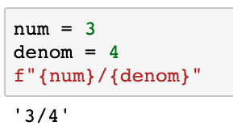
f-strings simplify string.format()
f-strings were first offered in Python 3.6
f-strings are a syntactic shortcut for string.format(values)
Expressions within {expr} are replaced with the expr
expr can be any valid Python expression
f-strings make your code much easier to write and read
Don’t forget the preceding ‘f’!

Slide 28
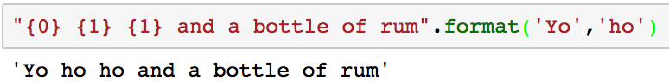
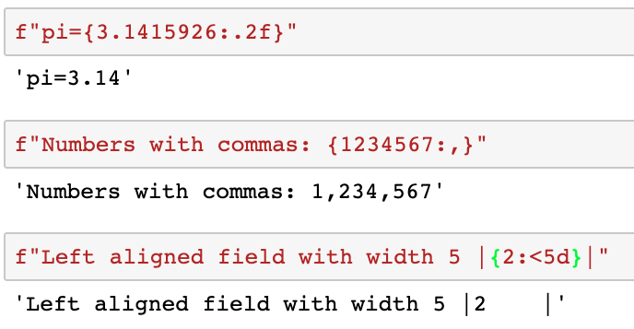
string.format()/f-string examples
https://mkaz.tech/python-string-format.html is a great site to see the many options

Slide 29
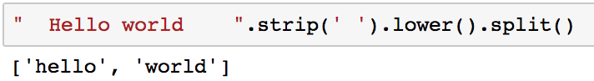
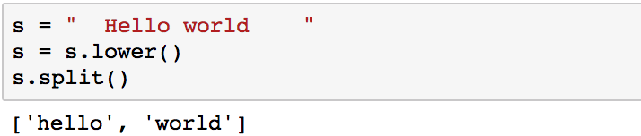
Chaining methods in a single call
We’ve seen that we can invoke class methods with obj.method(), e.g. ‘hello world’.split()
We can chain several calls together in a single statement
Is equivalent to
s = “ Hello world ”.strip(‘ ‘)
When chaining methods, the methods are applied left to right

Slide 30
Detecting palindromes
A string is a palindrome if the string is the same forward and backward
AbCdCbA
Two different approaches
Compare the string the reverse of the string: if string == reversed string then the string is a palindrome
Start at beginning and move to the right and at the end of string and move left, comparing subsequent characters until either the characters don’t match or you meet in the middle

Slide 31
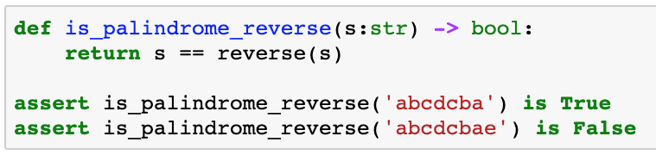
Palindrome detection: reverse
AbCdCbA
Note: reverse(string) is a homework assignment
This solution is very simple to implement and understand
It’s a great solution for short strings but…
Not very efficient

Slide 32
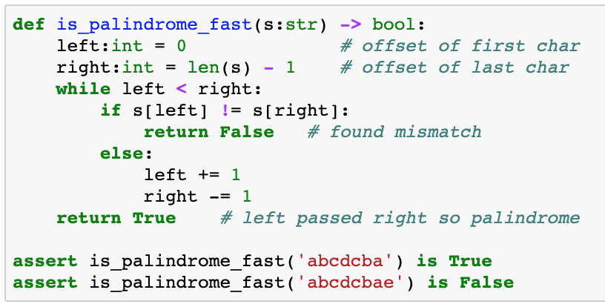
Palindrome detection: compare
AbCdCbA
left
right

Slide 33

Compare efficiencies
Considerations:
How efficient is each algorithm?
How quickly can we determine if a string is a palindrome?
What if the string is very long (a book)?
How frequently do we need to use this feature?
How hard to write and maintain both versions?
No “correct” answer for all situations

Slide 34
Summary
Strings are a fundamental data type in Python
There are many string functions to choose from
The most important include:
in, not in
Slices
find()
format()
f-strings
split()
strip()
join()

Slide 35


Slide 36
Working with files
Steps for reading from a file:
Get file name
Open the file
Read the file
Line by line
All at once into a list of lines
All at once into a buffer
Close the file

Slide 37
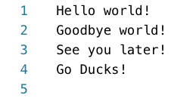
README file
Trailing \n

Slide 38
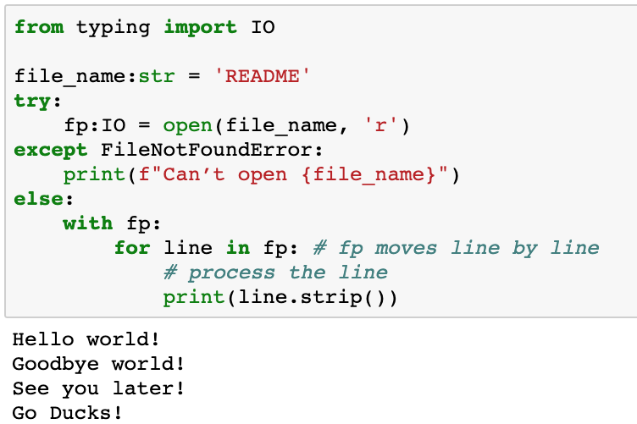
Reading a text file line by line
Strip the line to remove the trailing \n

Slide 39
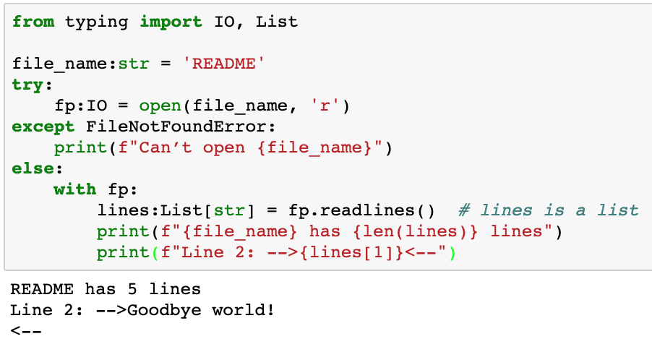
Reading a text file into a list of lines
readlines() returns a list of strings, one item for each line in the file
Each line ends with a \n

Slide 40
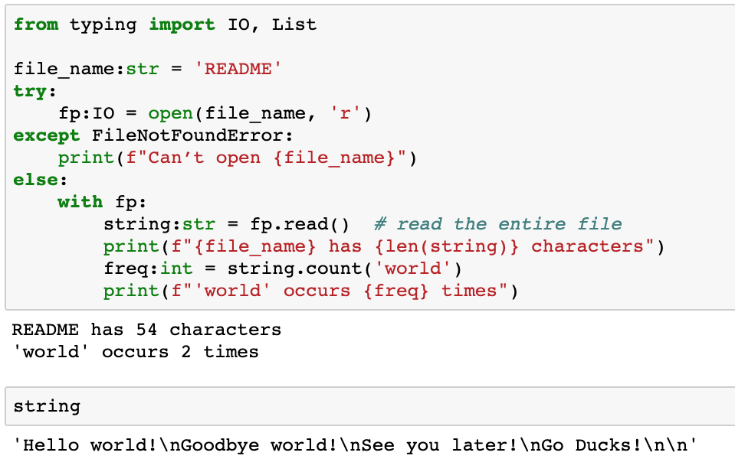
Reading a text file into a buffer
Line breaks are stored as ‘\n’

Slide 41
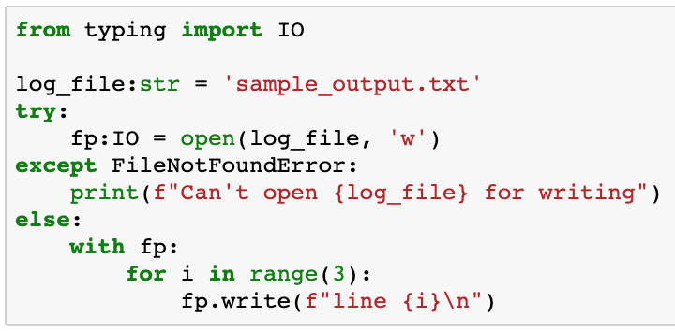
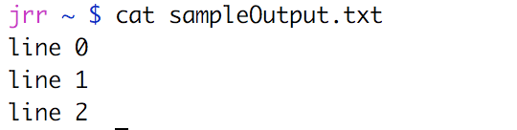
Writing to a text file
’w’ creates a new file if the file doesn’t exist or overwrites the file if it does exist
’a’ creates a new file if the file doesn’t exist or appends to the file if it does exist
Include ‘\n’ unless you want everything on one line

Slide 42
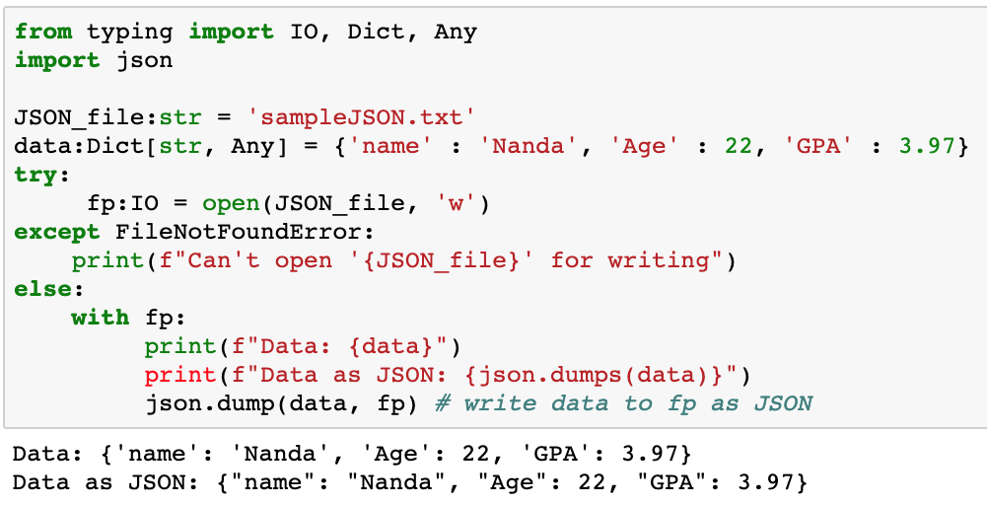
Writing JSON files
JSON is commonly used by web applications

Slide 43
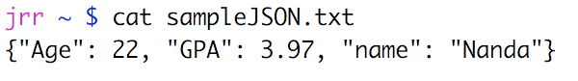
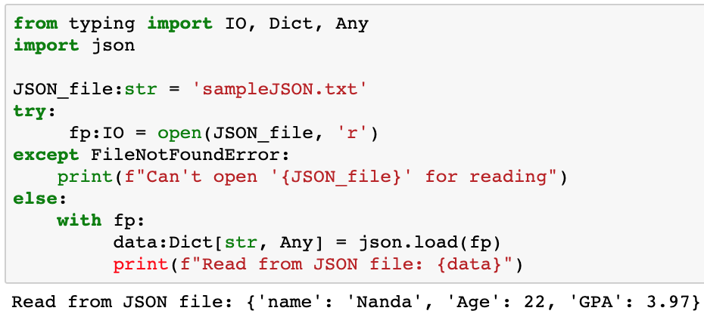
Reading JSON files

Slide 44
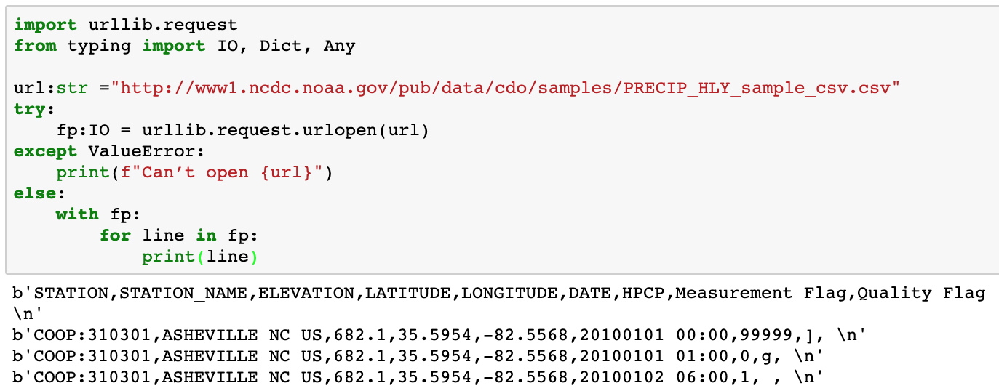
Reading from the Web
Python supports reading arbitrary URLs from the Web
Approach is analogous to reading from files

Slide 45
Reading from the Web
Several good solutions for reading from the web
Urllib – open arbitrary resources by URL
Requests – HTTP for Humans
BeautifulSoup4 – parses data from HTML and XML files
Scrapy – scraping and web crawling
Good solutions for parsing HTML, JSON, XML, etc.
Tweepy - reads from the Twitter feed

Slide 47
Coding style guidelines
We spend far more time reading than writing code
Following coding style guidelines/standards make code easier to read and understand
Same Code: Which would you rather read?
def fib(n):
“””
Return the nth element of the
Fibonacci sequence
“””
if n == 1 or n == 2:
return 1
else:
prev2, prev1 = 1, 1
while n > 2:
prev2, prev1 = prev1, prev1 + prev2
n -= 1
return prev1
def fib(n) :
if ((n==1 )
or (n == 2)): return 1
else:
prev2,prev1=1,1
while n> 2 :
prev2,prev1=prev1,prev1+prev2;n-=1
return prev1

Slide 48
Python Coding Style Guidelines
Coding style guidelines provide consistency
Coding style guidelines make code easier to read and understand:
Encourage consistency across a project or organization
Help the reader to recognize relevant chunks of code
Consistent use of white space
Consistent formatting of program elements
Avoid developing and using bad habits
If your project has a coding style then follow it
Otherwise adopt an existing coding style
Google: http://google.github.io/styleguide/pyguide.html
Python: https://www.python.org/dev/peps/pep-0008/

Slide 49
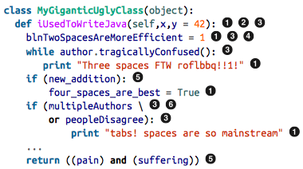
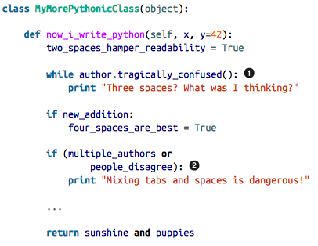
Python Style: Bad vs Good
Indentation issues
White space issues
Inconsistent case
Hungarian Notation
Extraneous parens
Extraneous line continuations
Source: How to Make Mistakes in Python
by Mike Pirnat
Copyright © 2015 O’Reilly Media, Inc. All rights reserved.

Slide 50
Sample Guidelines
Indentation: use 4 spaces per indentation level.
Blank lines:
Use blank lines sparingly in functions to indicate logical sections
Use two blank lines between top level function and class definitions
Use one blank line inside a class to separate method definitions
String quotes: use either single or double quotes consistently
Avoid multiple statements per line
Docstrings should be used for all public modules, functions, classes, and methods
Avoid global variables
Global constants are okay
Use parens sparingly
Explicitly close every file you open

Slide 51
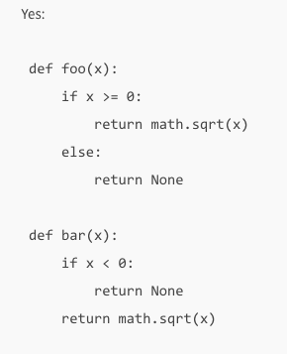
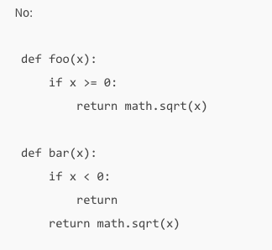
Return Statement Guidelines
Be consistent: if any return statement returns an expression, than all return statements should return an expression, including an explicit return None
What if x <= 0?

Slide 52
Naming Guidelines
Object | Naming Guideline | Example
Packages, Modules, Variables, Parameters, Local vars | lower_case_with_underscore | my_package my_module running_total
Classes, Exceptions | CapitalWords | ExceptionHandler Mammal
Functions, Method names | lower_case_with_underscore() | foo_bar()
Constants | CAPS_WITH_UNDERSCORE | MAX_INT

Slide 53
Coding guidelines summary
Coding guidelines improve code readability and maintainability
Don’t require a lot of effort
Coding guidelines are all about being consistent
Within your code
Within your organization
May seem to be much ado about nothing
Low cost, high reward

Slide 54

Questions?

